Slide 1
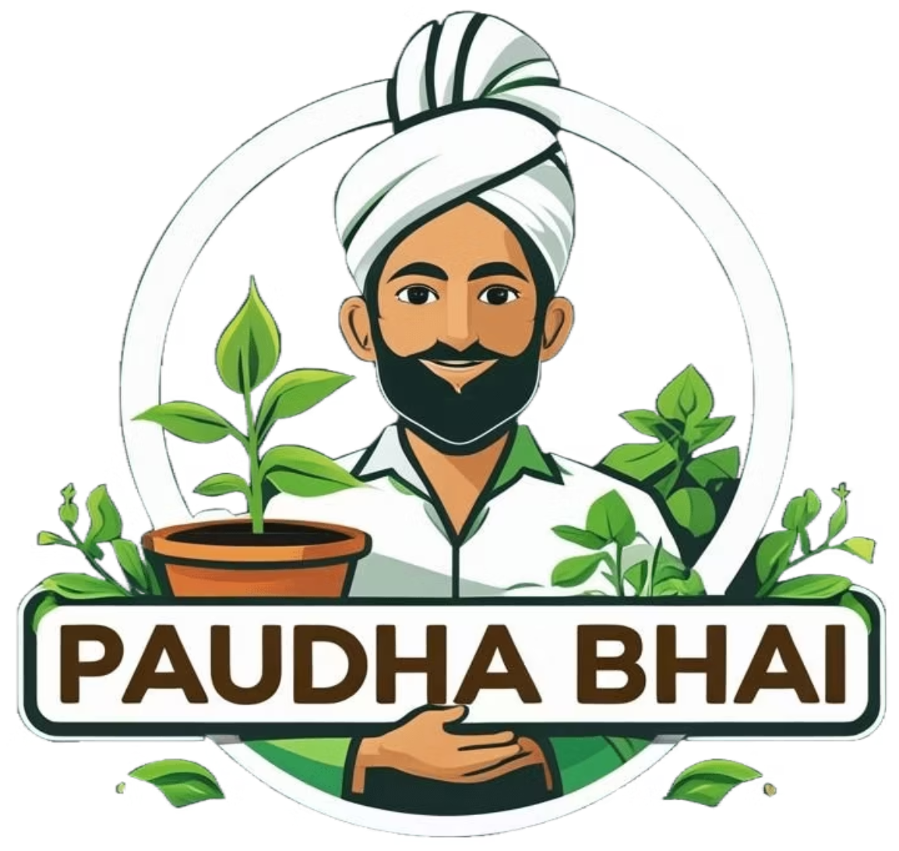
Paudha Bhai – AI se pucho, kya ugaana hai aaj?
Empowering urban Indians to embrace greenery through accessible tech and community. We offer a one-stop plant-shopping experience with expert guidance. Our target audience is young urban "plant parents" passionate about wellness and sustainability

Slide 2
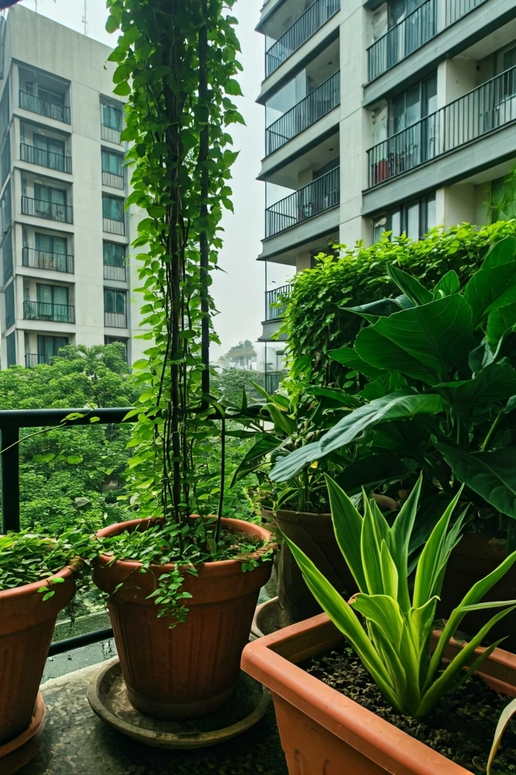

Vision & Mission
Our Vision
Empower every Indian urbanite to bring greenery into their daily lives.
Our Mission
Provide a one-stop plant-shopping experience with AI expert guidance and a vibrant community.
Target Audience
Young urban "plant parents" focused on wellness and sustainability. This trend is rapidly rising among India's youth.

Slide 3
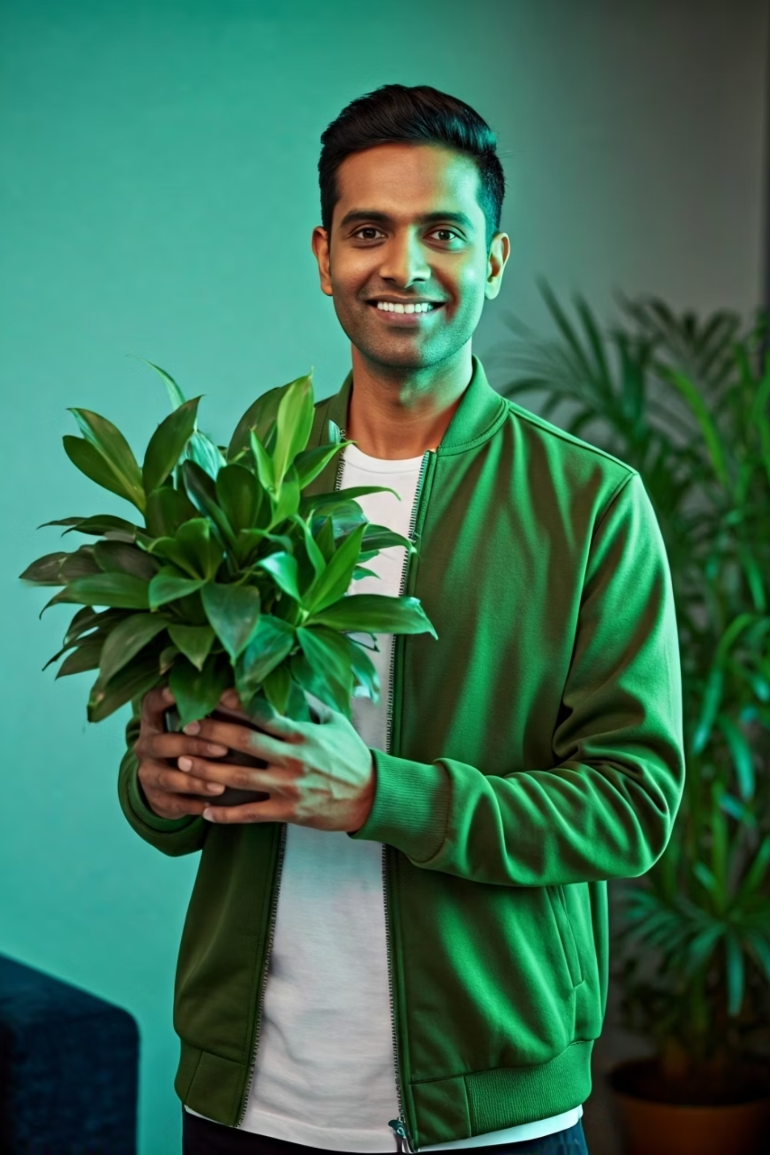



The Problem
Plant Care Gap
Seasonality & Logistics
Many new Indian plant parents struggle with choosing the right plants for their homes and ensuring their health. Reliable, localized advice is hard to find.
India's diverse climates challenge year-round plant supply. Live plants are easily damaged during transit across varied regions.
Fragmented Community
Indian gardening enthusiasts lack a central, engaging platform. Novice gardeners often feel isolated without proper guidance and peer support.

Slide 4
Our Solution – Product & Features
Online Nursery
Community Forum
Wide selection of healthy indoor and outdoor plants, plus planters and care kits.
Social hub for users to ask questions, share photos, and post tips. Fosters peer support and loyalty.
Plant Expert (GPT-4 AI Bot)
Subscription Service
24/7 virtual botanist for plant recommendations and disease diagnosis. Provides personalized tips and DIY cures.
Optional "plant-of-the-month" or care-kit subscriptions for recurring revenue. This model is gaining popularity.

Slide 5

Business Model
Direct Sales
Recurring Revenue
B2B & Gifting
Profit from plant and accessory orders via retail e-commerce.
Corporate and bulk programs for office greenery and eco-gifts.
Subscription plans boost customer lifetime value. Plant kits are a growing trend.
Market leaders like Ugaoo validate strong customer demand, achieving 1 million+ orders and ~₹100 crore ARR in 3 years.

Slide 6
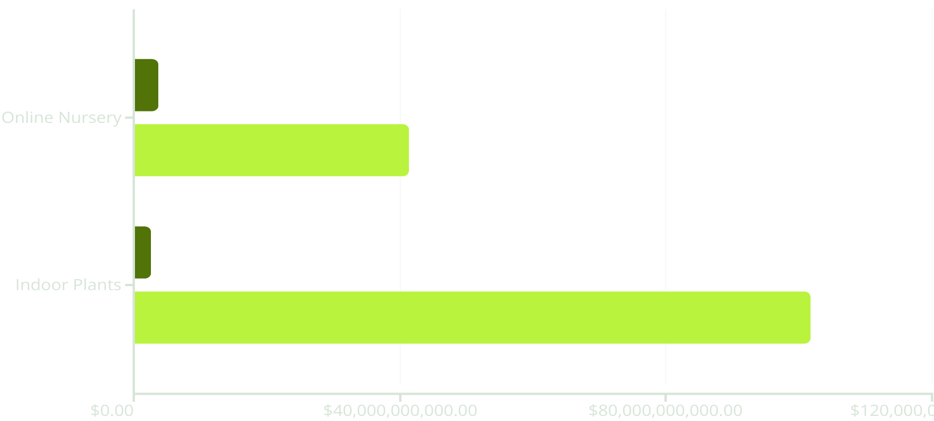
Market Opportunity
India's booming e-commerce landscape is fueling a vast and rapidly expanding opportunity in the online plant market. Our projections highlight significant growth:
Current (2024)
Projected
These figures underscore immense market potential: the Online Nursery market is projected to exceed $41 billion by 2030, and the Indoor Plants segment is set to soar past $101 billion by 2033.

Slide 7





Technology Stack
MERN Stack
Node.js, Express.js, React.js, MongoDB for full-JavaScript synergy and fast development.
Secure Auth
Firebase Auth for secure user logins.
Seamless Payments
Razorpay API for smooth Indian payment processing.
Scalable Deployment
Vercel for global scalability.
AI Integration
OpenAI's GPT-4 powers our Plant Expert for sophisticated advice.

Slide 8


Competitive Advantage
AI-Powered Expertise
GPT-4 bot provides instant, personalized plant advice and disease cures.
Engaged Community
Fosters peer-to-peer learning, building loyalty and word-of-mouth.
Youthful Eco Brand
Fresh, Instagram-friendly image and gamified UX appeal to millennials and Gen Z.
Tech-Driven Operations
Leverages cutting-edge tech for efficient growth and consistent quality.

Slide 9




Conclusion
AI-Powered Future
Thriving Market
Leveraging GPT-4 for smart plant care and personalized advice.
Tapping India's booming online nursery and indoor plant segments.
Strong Foundations
Engaged Community
Robust MERN stack and diverse revenue models ensure growth.
Building loyalty through a vibrant social hub and youthful brand.

